Slide 1
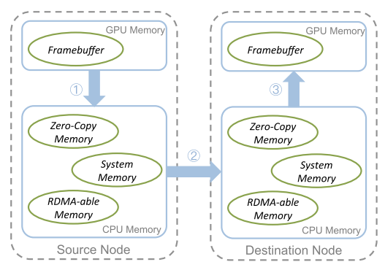
Notes: Isometry: A Path-Based Distributed Data Transfer System ^{[1]}
I. Applications
II. Challenges
Make a number of multi-hop decisions together, including allocating intermediate buffers and deciding their size to hold temporary data, and the choice of how and where to perform data layout conversions.
Implement path-specific synchronization and management.
Reuse intermediate buffers to satisfy all dependencies
Support scheduling policies such as prioritizing a transfer by additional coordination both within a transfer and across transfers.
Data transfers in parallel systems. Specifically, path-based distributed data transfer system.
IV. Conclusions
Figure 1: Data transfer between GPU framebuffers on different nodes [1].
Speed up data transfers by up to 2.2×.
Reduce the completion time of high priority transfers by up to 95% compared to the baseline Realm data transfer system. Evaluate Isometry on three benchmarks and show that Isometry
Reduces transfer time by up to 80% and overall completion time by up to 60%.
III. Methods
By using graph, dynamically select efficient paths for data transfers based on the connectivity between memories, the bandwidth for each connection, and the layout of the instance (a collection of data in a specific memory) being transferred. Please refer to next page.
[1] https://dl.acm.org/doi/10.1145/3205289.3205301

Slide 2
Notes: Isometry: A Path-Based Distributed Data Transfer System ^{[1]}
I. 应用
II. 难点
并行系统中的数据传输。尤其是，基于路径的分布式数据传输系统。.
作出多跳决策，包括分配中间缓冲区并决定它们的大小以保存临时数据，以及选择如何以及在何处执行数据布局转换。
实施特定路径的同步和管理。
重复使用中间缓存区以满足所有依赖项。
支持调度策略，例如通过在传输内和传输间的额外协调来确定传输的优先级。
IV. 结论
Figure 1: Data transfer between GPU framebuffers on different nodes [1].
将数据传输速度提高 2.2 倍。
与作为基准比较的 Realm 数据传输系统相比，将高优先级传输的完成时间减少多达 95%。
比较三个基准，显示 Isometry减少高达 80% 的传输时间和高达 60% 的整体完成时间。
III. 方法
通过使用graph，根据内存之间的连接性、每个连接的带宽以及正在传输的instance(内存中的数据集合)的布局，动态选择数据传输的高效路径。请参阅下一页。
[1] https://dl.acm.org/doi/10.1145/3205289.3205301

Slide 3
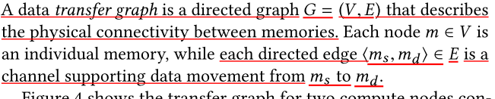
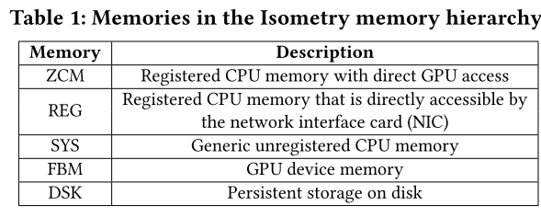
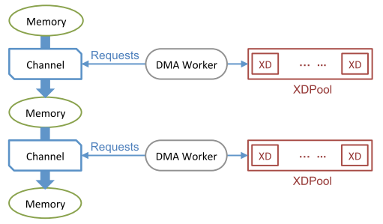
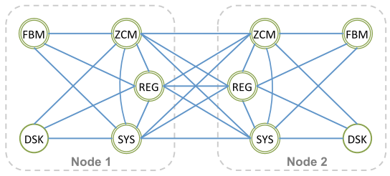
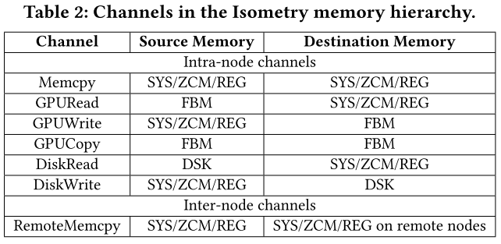
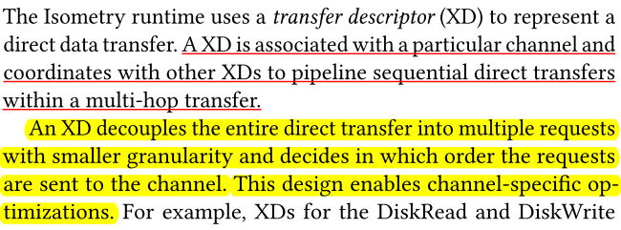
Notes: Isometry: A Path-Based Distributed Data Transfer System ^{[1,2]}
III. Methods-Model and Definitions
s
* Tables and figures source: [1]
* DMA: Direct memory access
* XD: transfer descriptor
[1] https://dl.acm.org/doi/10.1145/3205289.3205301

Slide 4
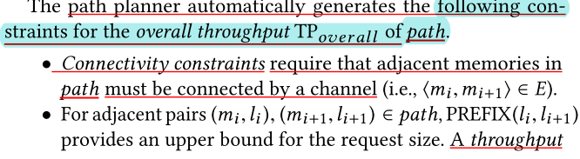
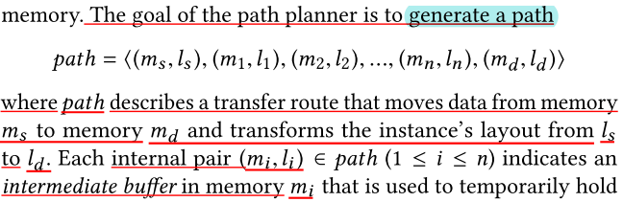
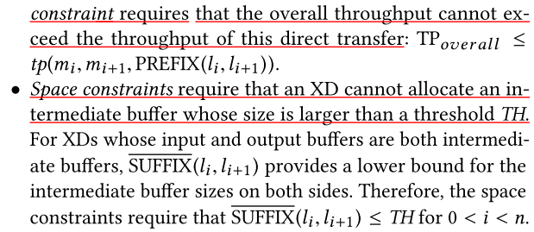
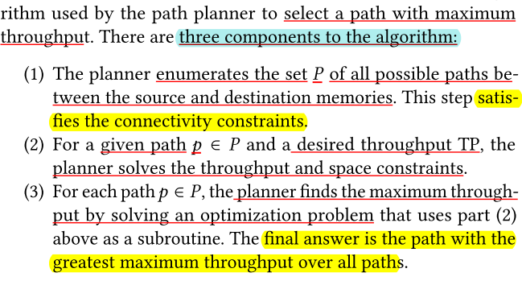
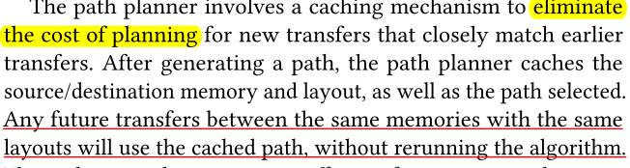
Notes: Isometry: A Path-Based Distributed Data Transfer System ^{[1,2]}
III. Methods-Find the data transfer path
[1] https://dl.acm.org/doi/10.1145/3205289.3205301

